Slide 1
Web Scraping Using R
Harsh Parikh
Sr.Consultant,
CGI Inc., Halifax
20-Sep-2019

Slide 2
Agenda
Introduction of web scraping
Introduction of R programming language
Accessing R
Demo
Q&A
References

Slide 3
Introduction of web scraping
What is web scraping?
Web scraping is a technique for gathering data or information from web pages. A scraper is a script that parses an html site.
Examples:
Maintaining price history of a product from online shopping site. (Amazon, eBay, etc…)
Extract price history of shares or mutual fund from financial website.
Track ratings of a song or movie from the websites like IMDB.
There are hundreds of examples on the internet for web scraping its just a google away ;-)
Notes:
Scrapers are bound to fail in cases of site re-design.

Slide 4
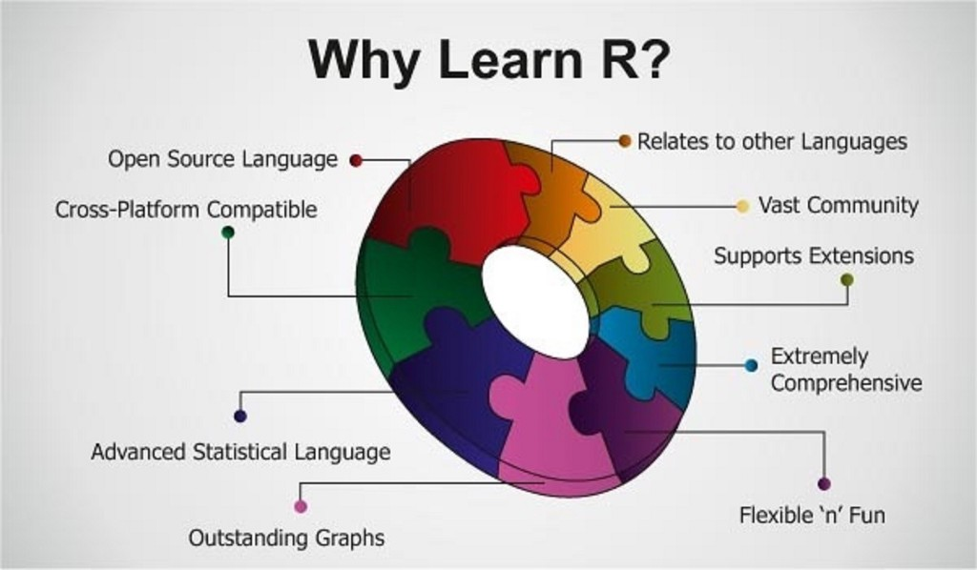
Introduction of R programming language
What is R Programming language?
R is a programming language and free software environment for statistical computing and graphics supported by the R Foundation for Statistical Computing. The R language is widely used among statisticians and data miners for developing statistical software and data analysis.
image source — http://bigdatasciencetraining.com/importance-of-learning-r-for-data-science/
Notes:
Scrapers are bound to fail in cases of site re-design.

Slide 5
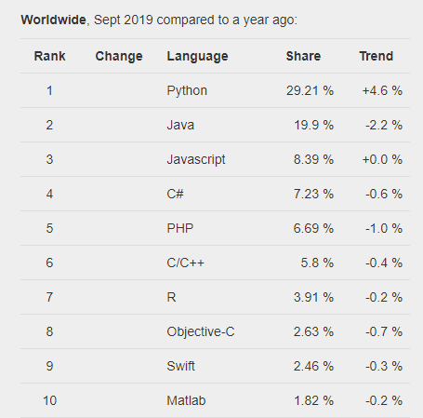
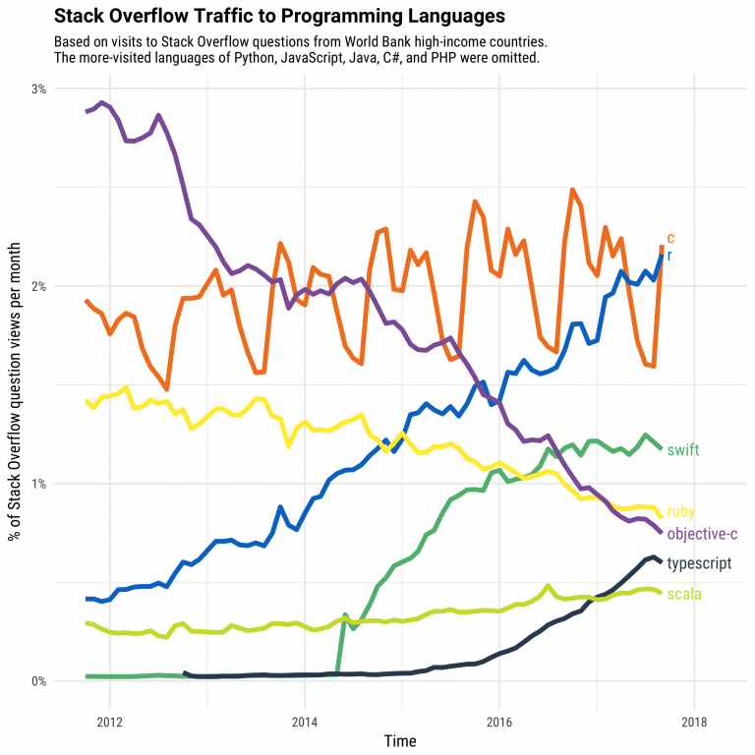
Little more on R
https://pypl.github.io/PYPL.html
https://www.guru99.com/r-programming-introduction-basics.html

Slide 6
Accessing R
R Studio
Jupyter Notebook
Any Text Editor
The most popular IDE in the market for R
It can be installed on most operating system as a software
It also has a server version for many popular operating systems
Support for latest virtualization technologies like Docker
Cloud hosted service by R studio
One of the most popular environments in data science.
Can be installed via Anaconda for windows
Can be installed via pip in Unix and other popular operating systems
Just like any other programming language we can integrate text editor with R

Slide 7
References
https://rstudio.cloud
https://www.r-project.org/
https://www.rstudio.com/
https://github.com/
https://ca.finance.yahoo.com/quote/GIB-A.TO/
https://pypl.github.io/PYPL.html
https://www.guru99.com/r-programming-introduction-basics.html
image source — http://bigdatasciencetraining.com/importance-of-learning-r-for-data-science/
https://www.freecodecamp.org/news/an-introduction-to-web-scraping-using-r-40284110c848/
Notes:
Scrapers are bound to fail in cases of site re-design.

Slide 8
Thank you !!!!!!!!

Slide 9
Q&A

Slide 10
Demo Subject: Extracting Script rates from Yahoo finance
Software: R
IDE:R Studio
Host: Cloud
URL: https://rstudio.cloud

